Slide 1
Sprint 3 Presentation
Team Members: Patrick Gallagher, Spencer Russell, Tianyi Zhang, and Hank Zhu

Slide 2
User Stories
● As a user, I want a help function for the application. So that I know, exactly what the program is doing - 8pts
● As a user, I want to make a password for the application, so that I can protect my stocks. -16 pts
● As a user, I want to have data graphs for different time periods, so that I can see the trends more conclusively - 4 pts
● As an investor, I want to keep hold of my personal shares. So that I can monitor my own financial gain.-4 pts

Slide 3
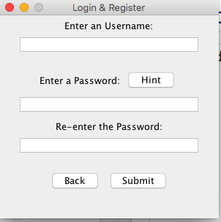
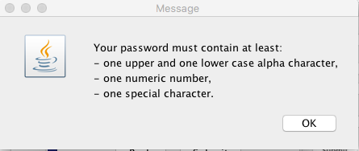
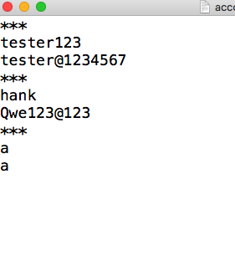
Registration

Slide 4
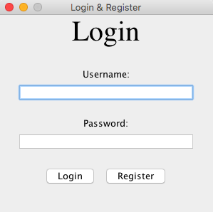
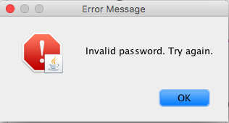
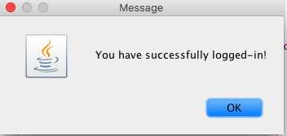
Logging

Slide 5
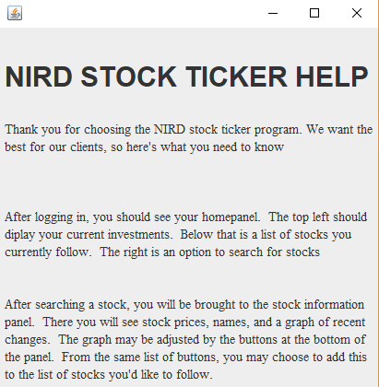
Help window
One of our user stories included a request for an information window.
This allows the users to familiarize themselves with the program.
This frame is accessible from the “?” button on the main menu.

Slide 6

Saving Stocks
Writes the stock information by using the add button
Displays the stock information in a button using HTML
How many stocks the user bought
Percentage Change
Decrease or Increase

Slide 7
